Slide 1

Job Portal Website Project Synopsis Presentation Date: 01/05/2023
Major Project (IMW651)
Degree : BCA(MAWT)
Project Guide:
Mr. Sanjeev Soni
(Sr. IT Faculty, CCSIT, Inurture)
Tushar Kumar (TCA2055008)
FACULTY OF ENGINEERING & COMPUTING SCIENCES
TEERTHANKER MAHAVEER UNIVERSITY, MORADABAD

Slide 2

Team Details
Student Name | Role
Purushartha Singh Thakur | Designing, Research, Development
Tushar Kumar | Testing
2

Slide 3
Table of Contents
Contents:
Project Brief
Methodologies, Technologies or Tools Used
Context Diagram
Entity Relationship Diagram
Data Flow Diagram
3

Slide 4
Project Brief
The aim of the project is to build job portal where anyone looking to get employed can visit and apply for any Job openings available in any field. For recruiters, they can post any job opening notices on the portal where potential candidates can find and apply for the opening.
Functions:
Login/Signup with verification.
Verify authenticity of the recruiters.
Posting job opening notices/ads.
Profile Performance for candidates and recruiter’s panel.
Set preferences/filter for job search.
Blog, Tips/Tricks section for candidates.
Inbox for communication.
Review/Ratings of companies.
4

Slide 5
Methodologies/ Technologies/ Tools to be used
Front End:
HTML, CSS
Material UI/Tailwind CSS
React
Back End:
NodeJS
Express
Database:
MongoDB
Tools:
VS Code
5

Slide 6
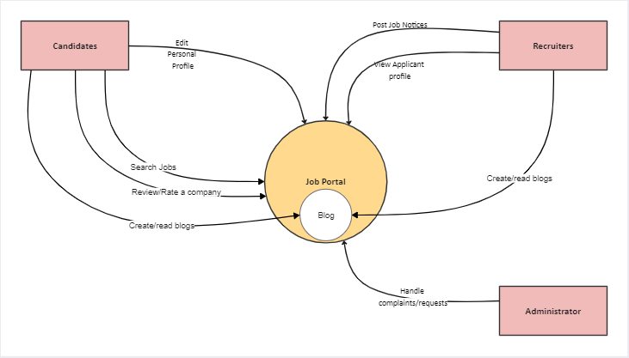
Context Diagram (Overall Project)
6

Slide 7
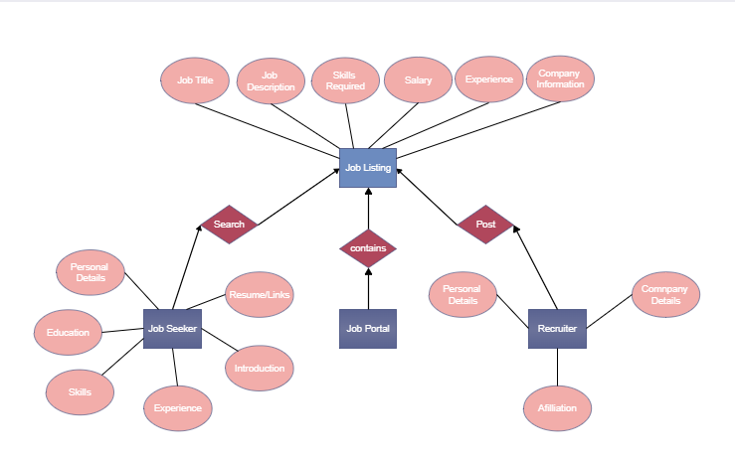
Entity Relationship Diagram (ERD)
7

Slide 8
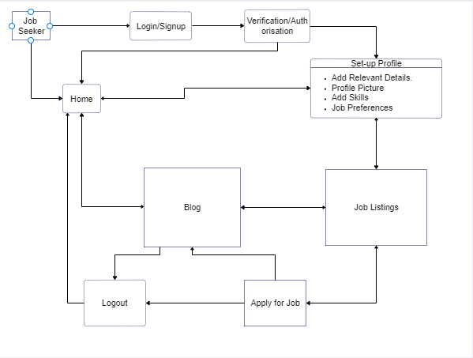
Data Flow Diagram (DFD)
8

Slide 9
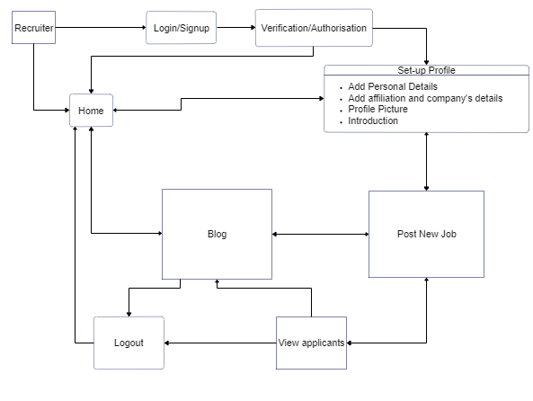
Data Flow Diagram (DFD)
9

Slide 10
\
Advantage of The Project
Strong Points of Job Portal Website:
Recruiters will be verified to prevent fake job postings.
Anyone can share reviews about their experience with a company.
Candidates can view their past applications
Through the Profile Performance section, candidates can gain insight on where to improve in order to increase their chances for employment.
Job recommendation based on the skillset of the candidate.
Recruiters can view the profiles of candidates.
10

Slide 11
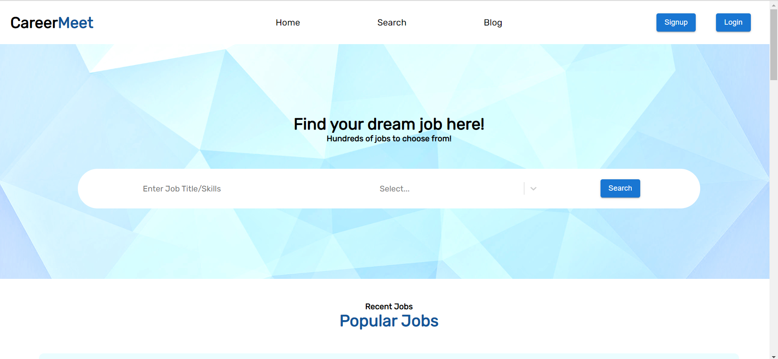
Project Outcome
Home

Slide 12
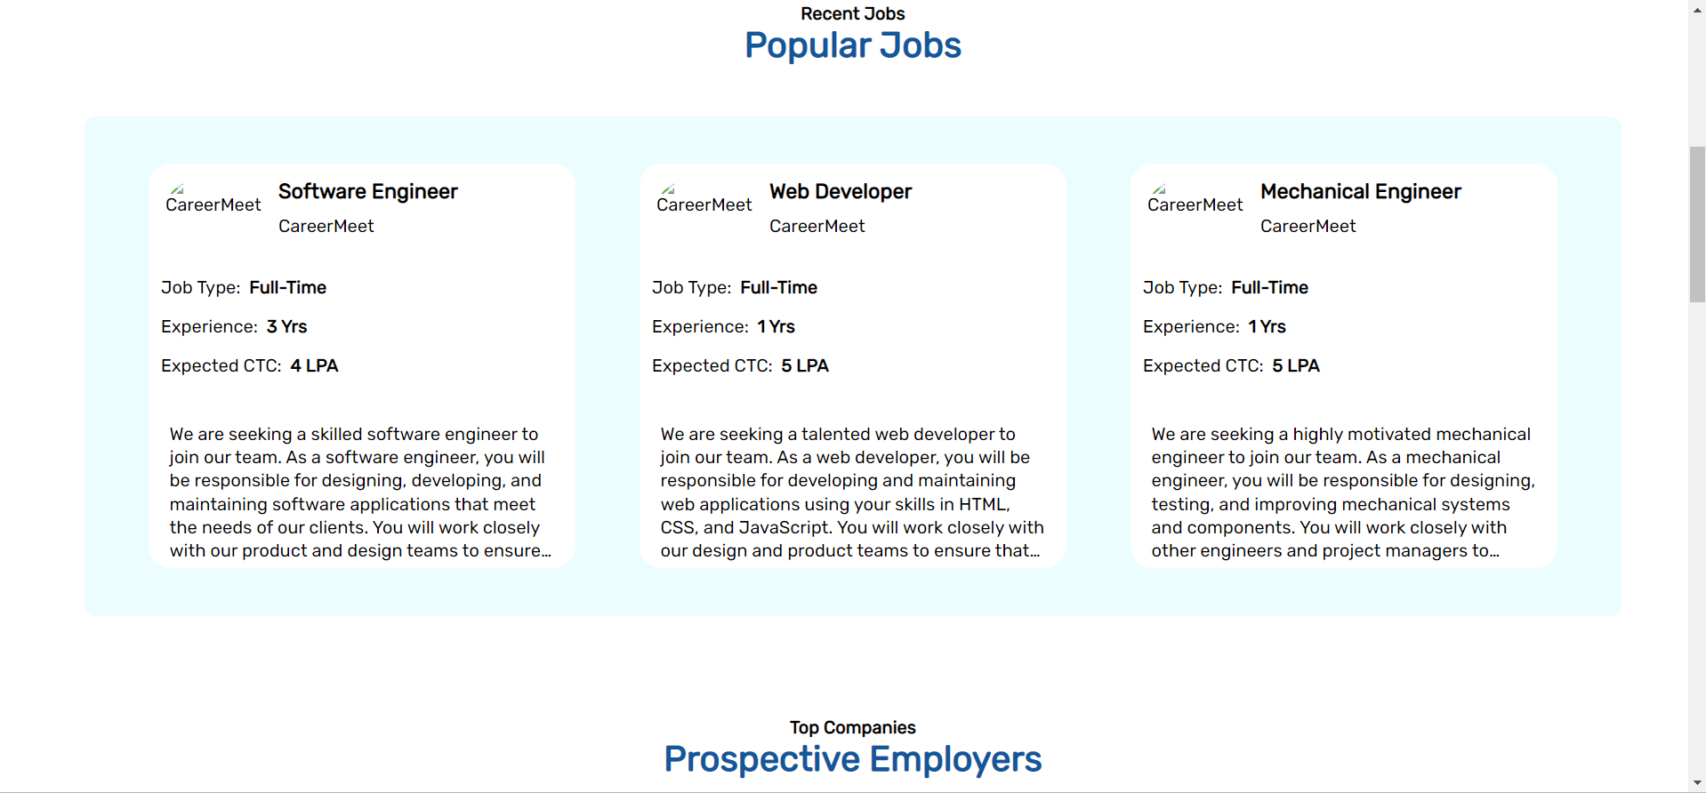

Slide 13
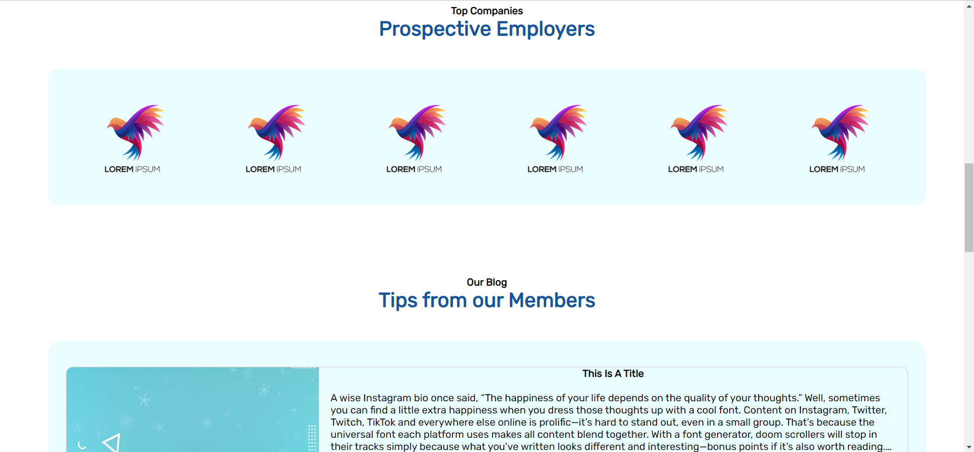

Slide 14
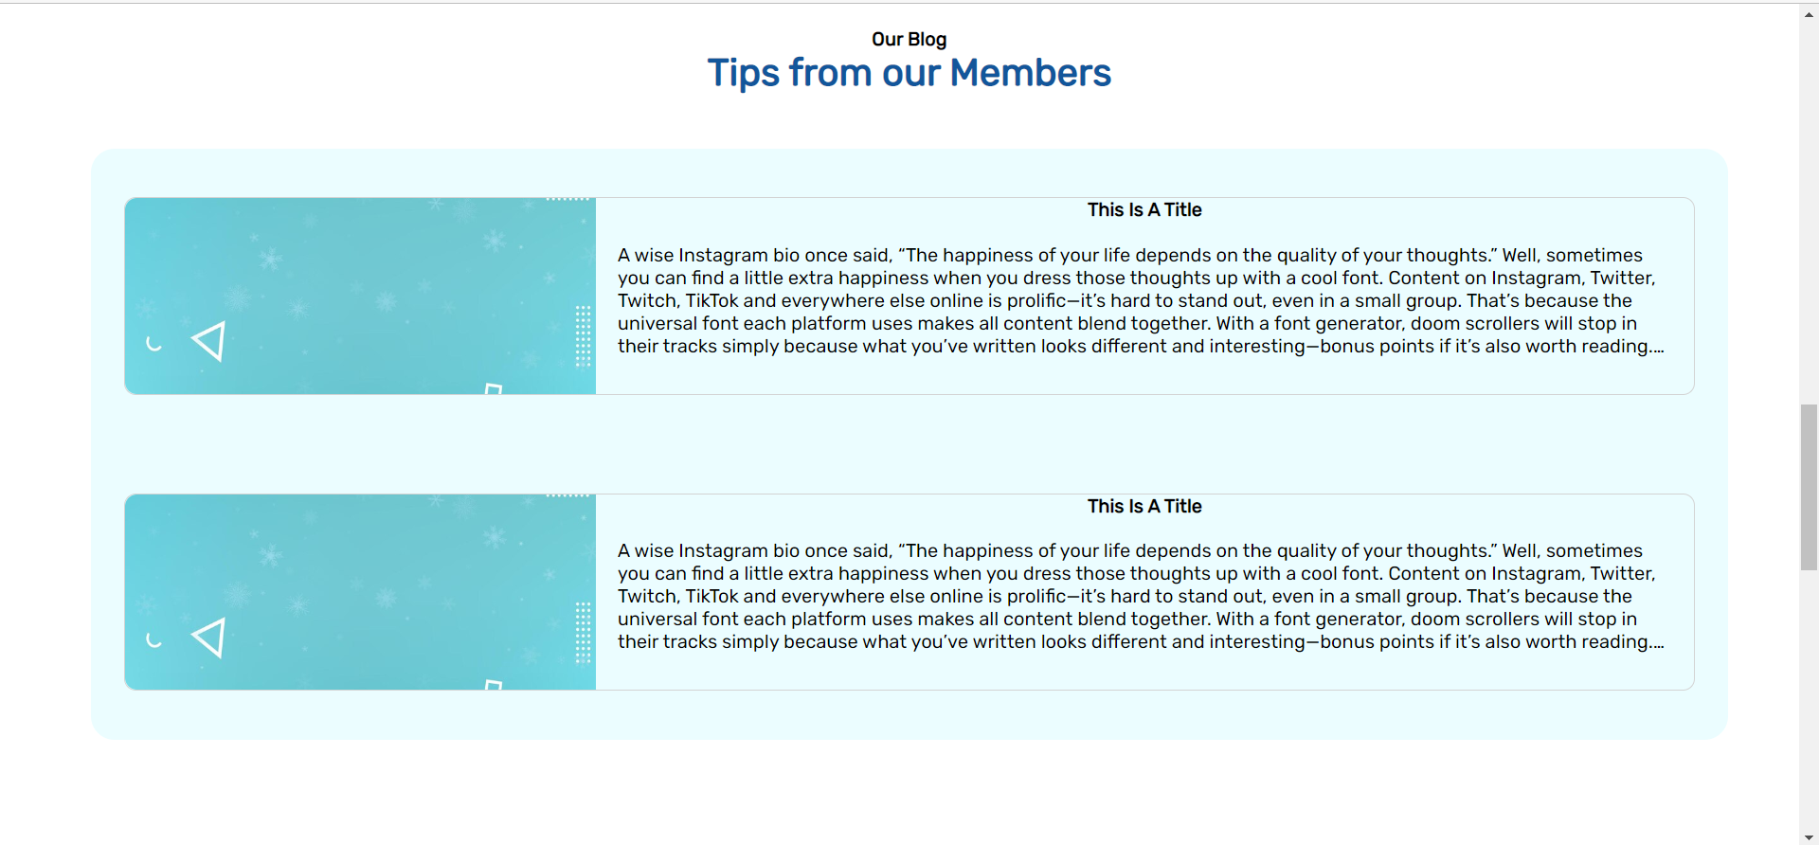

Slide 15
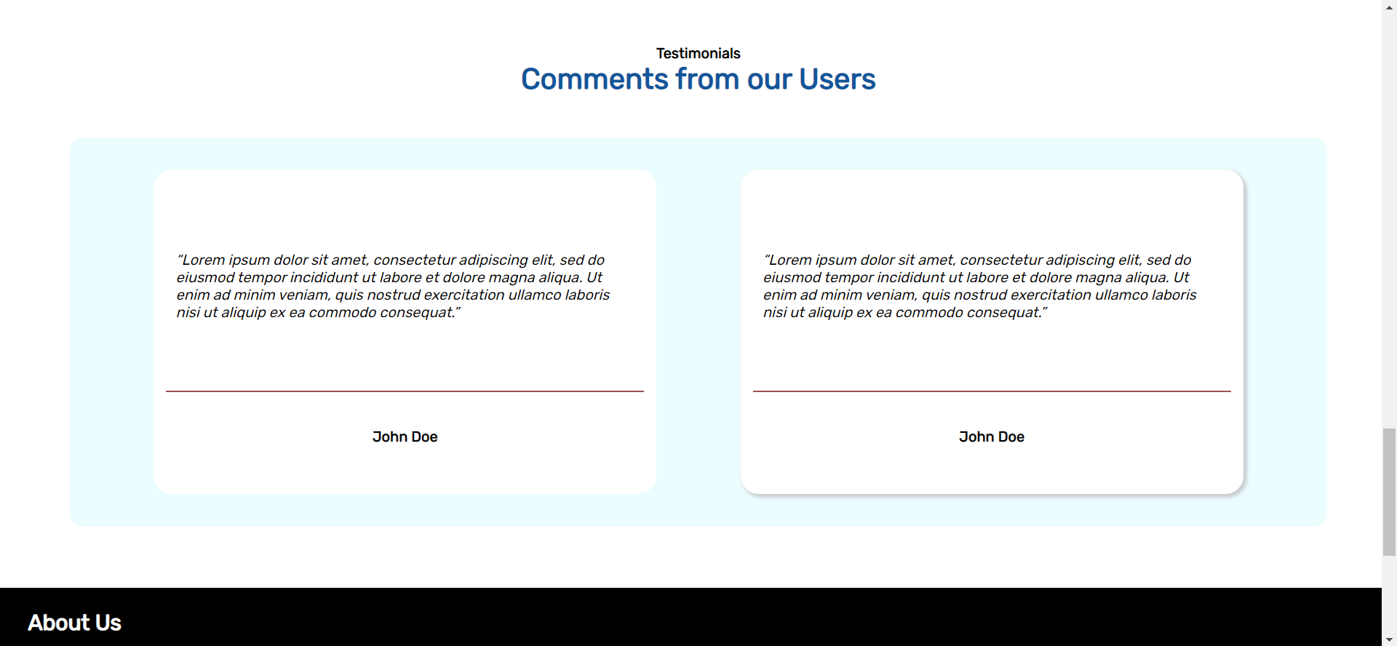

Slide 16
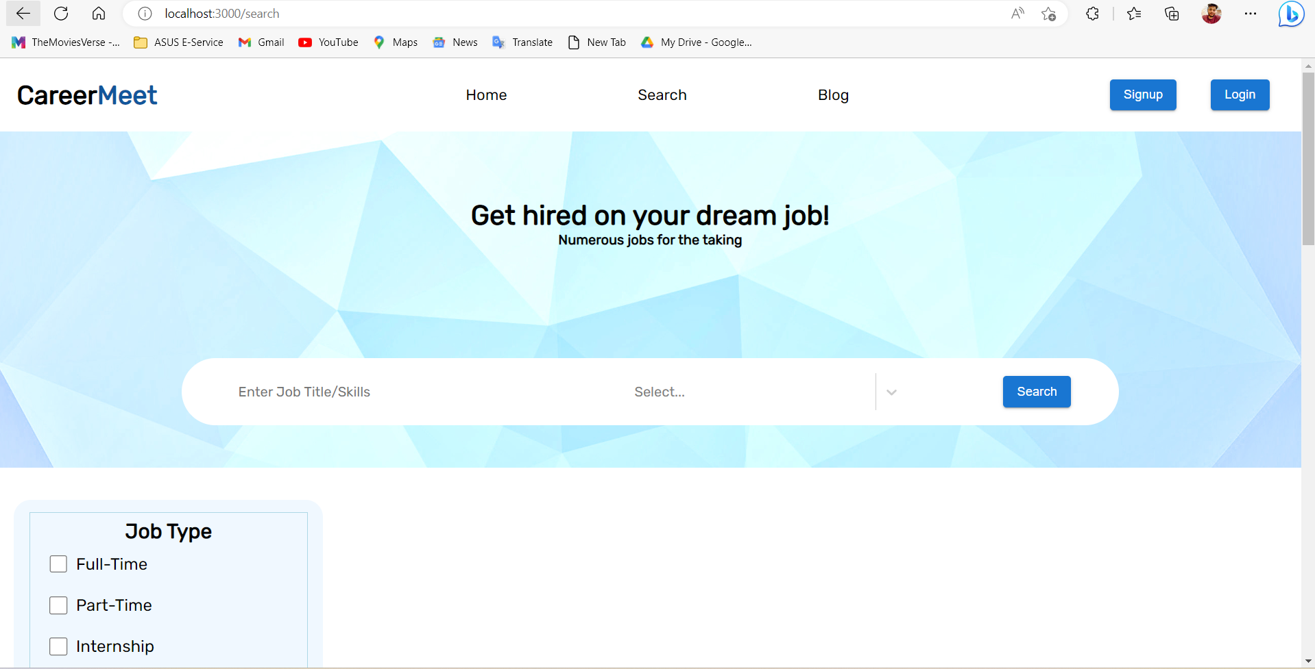
Search

Slide 17
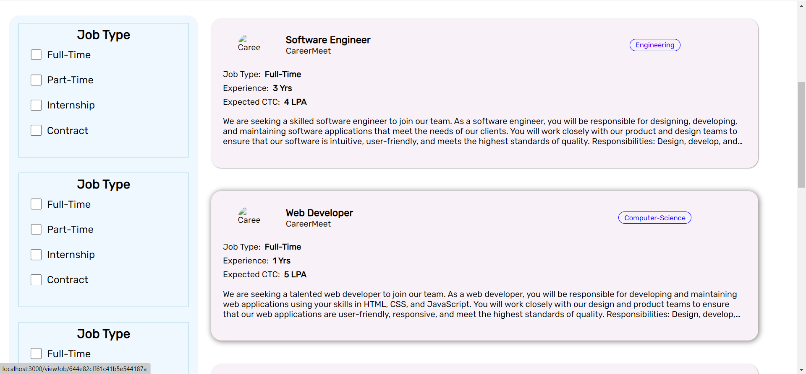

Slide 18
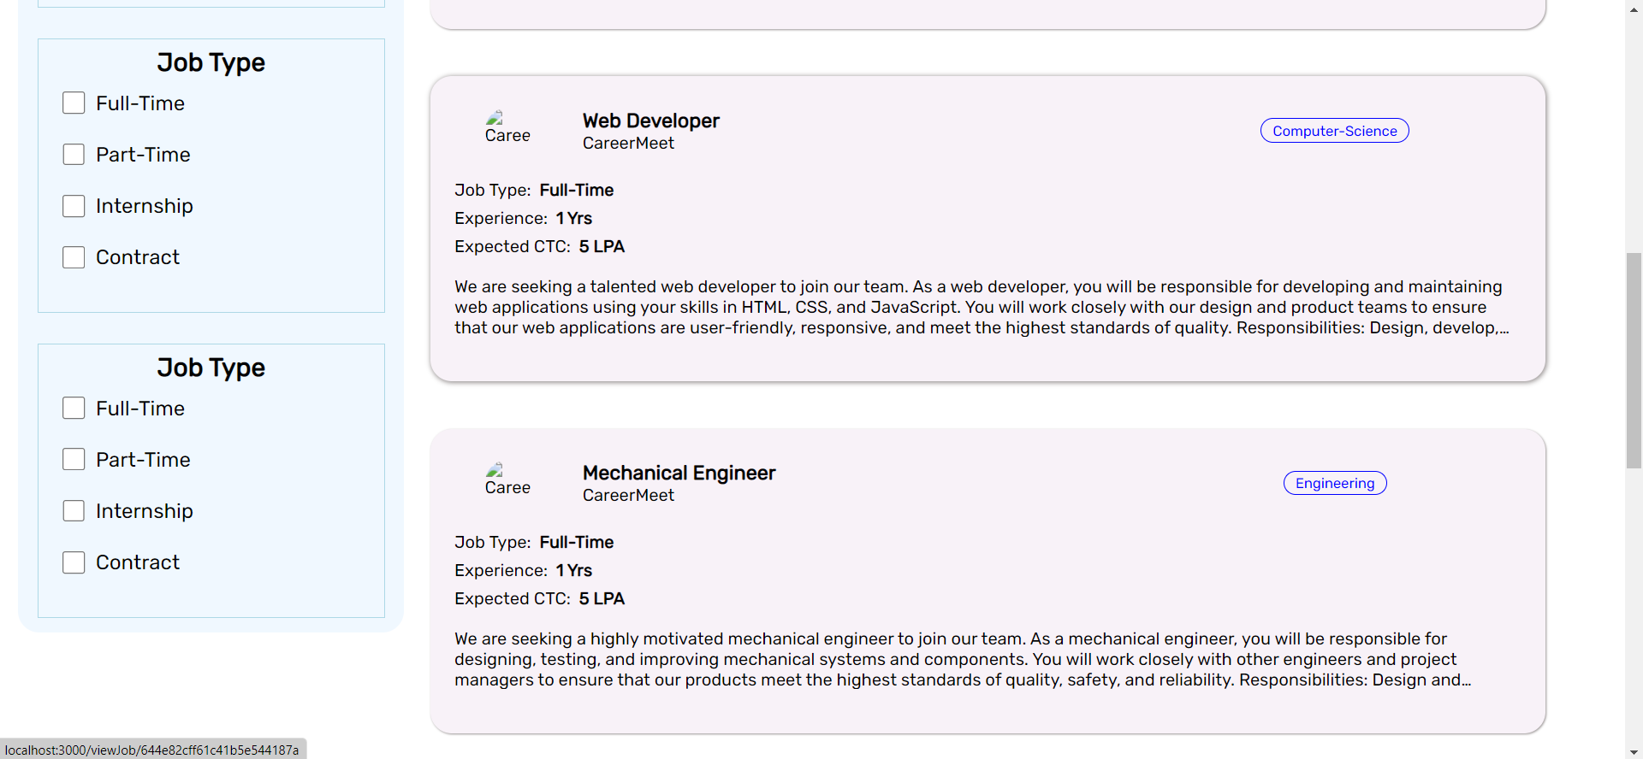

Slide 19
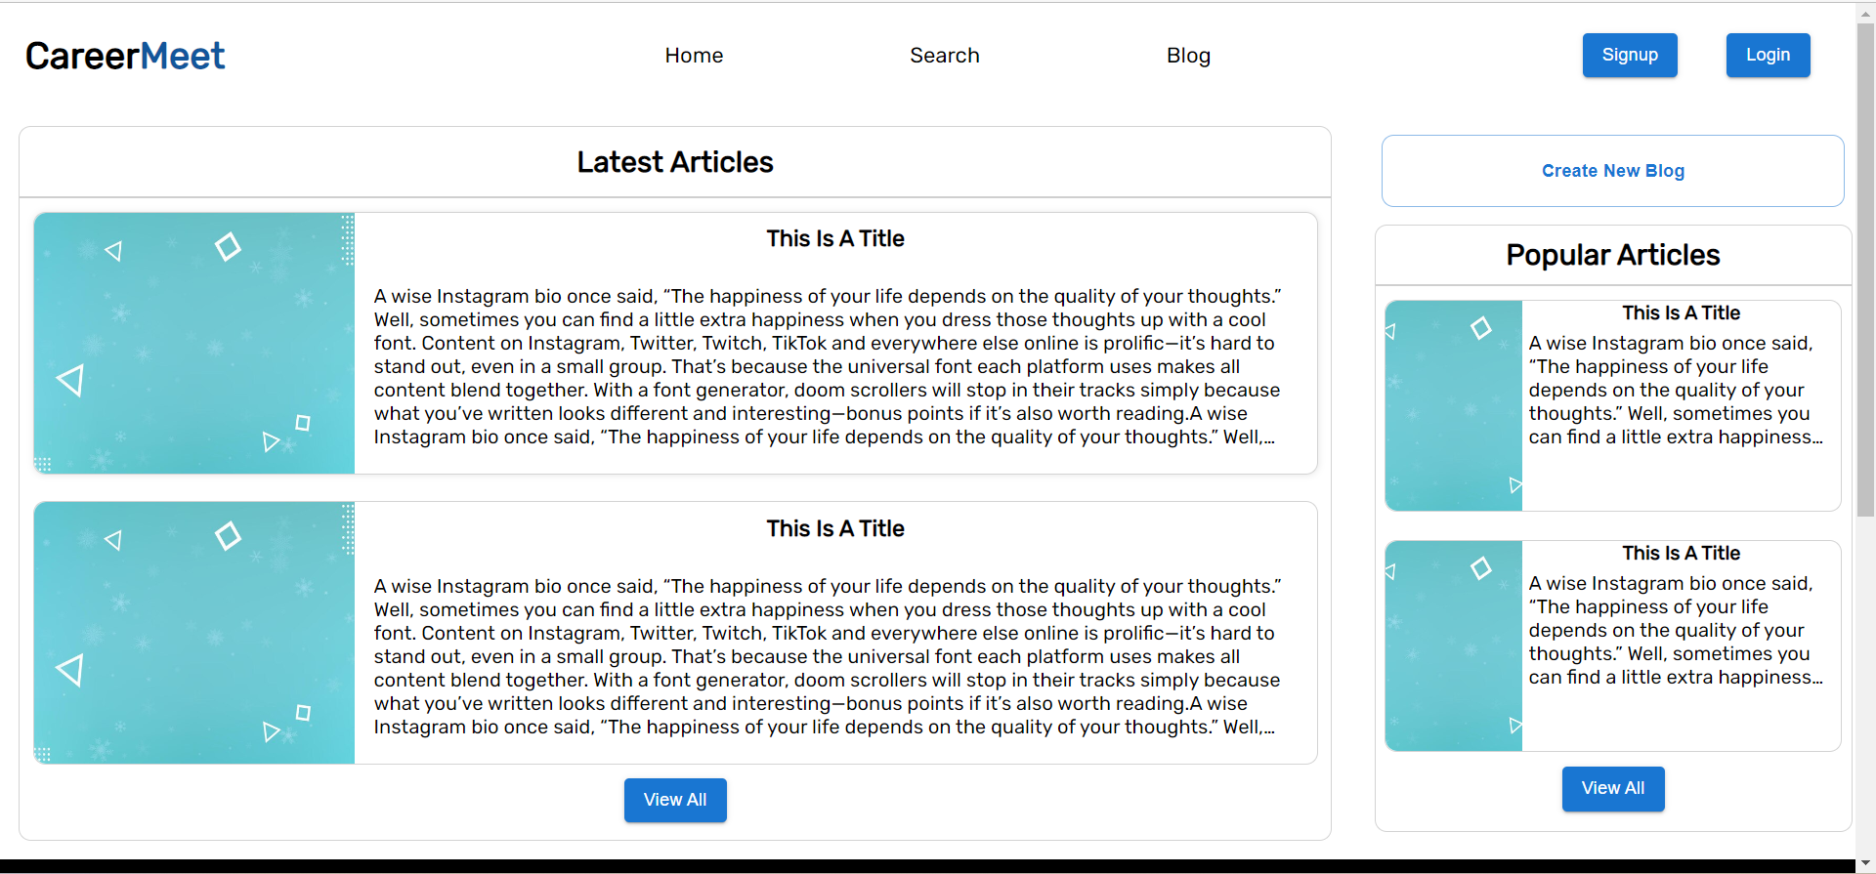
Blog

Slide 20
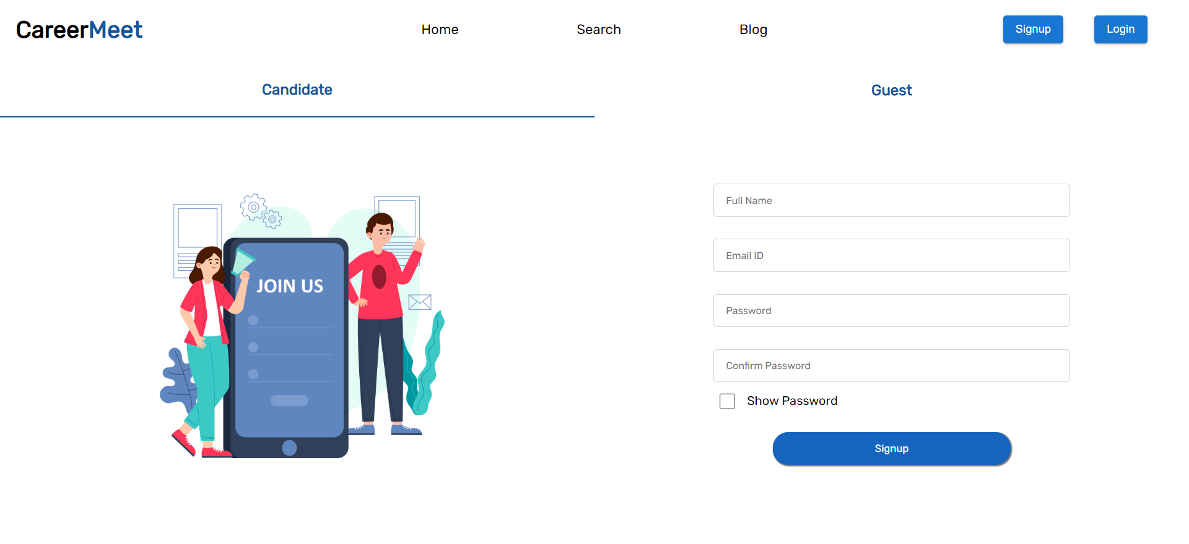
Signup(Candidate)

Slide 21
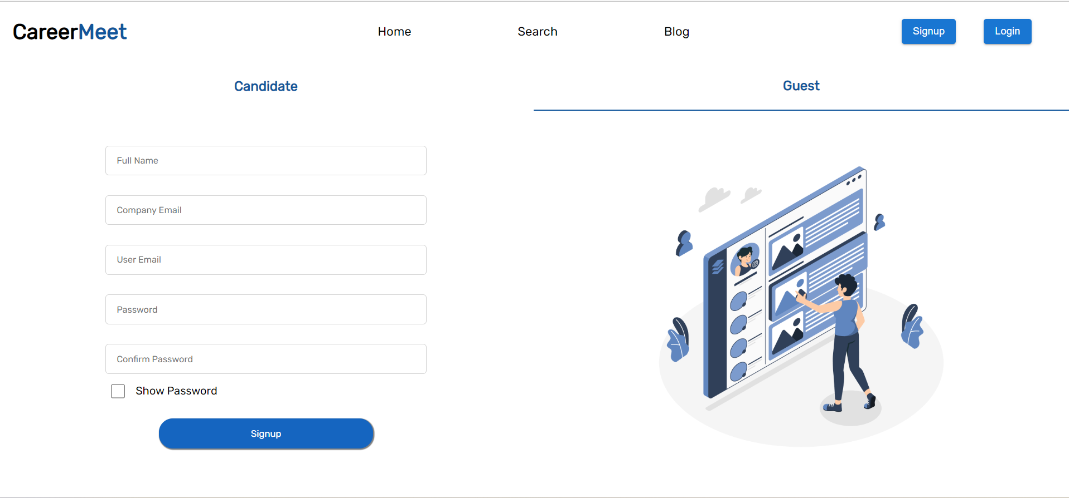
Signup(Employer)

Slide 22
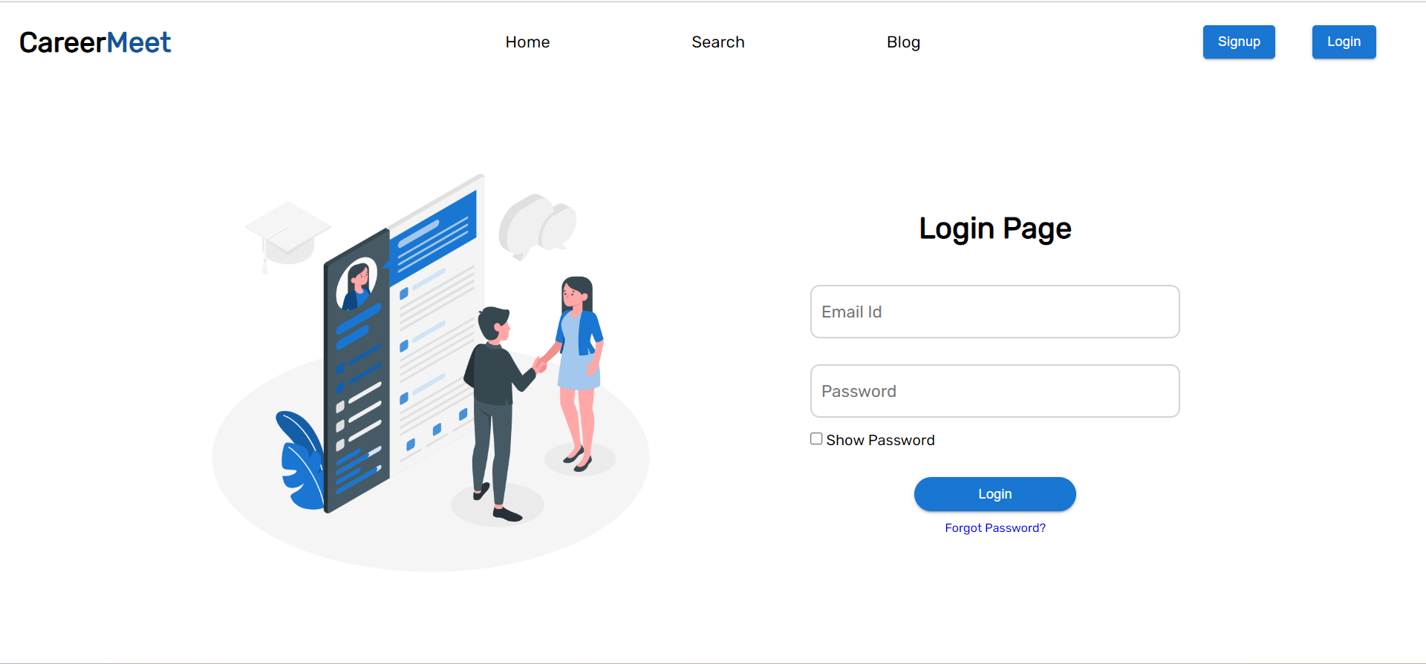
Login

Slide 23
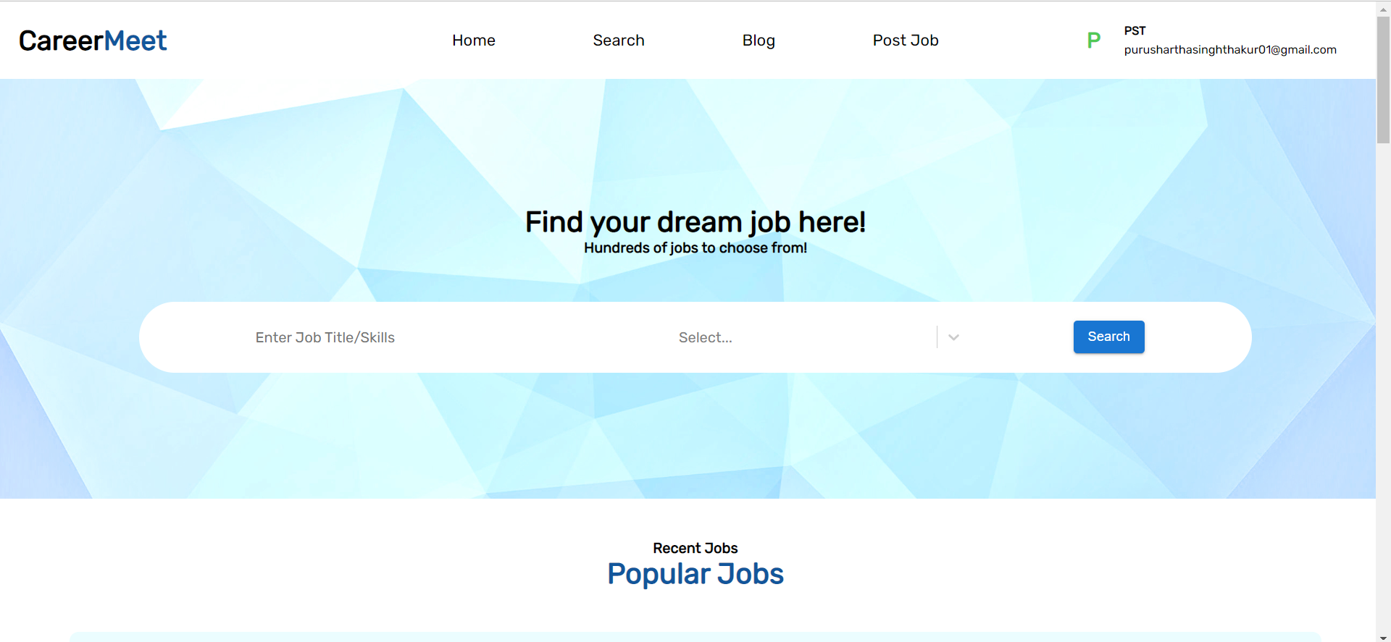
Home(After login)

Slide 24
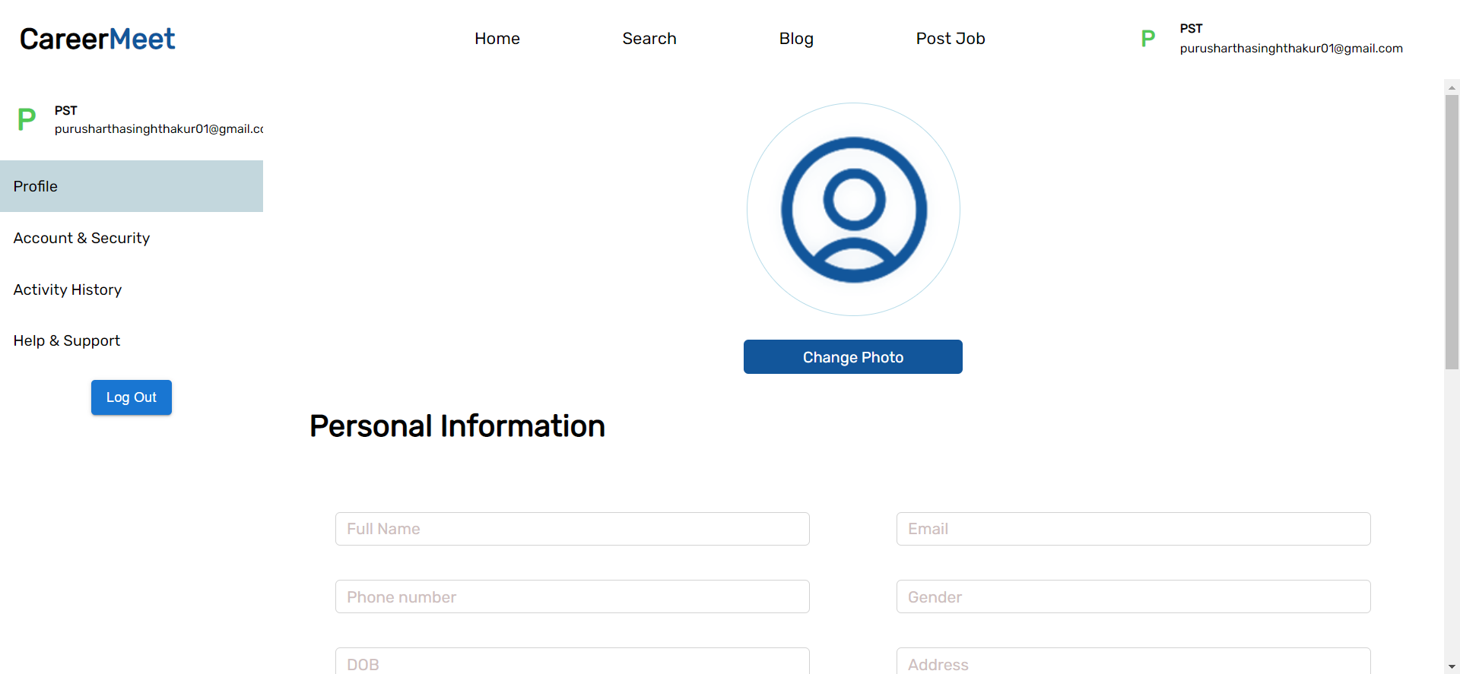
Profile

Slide 25
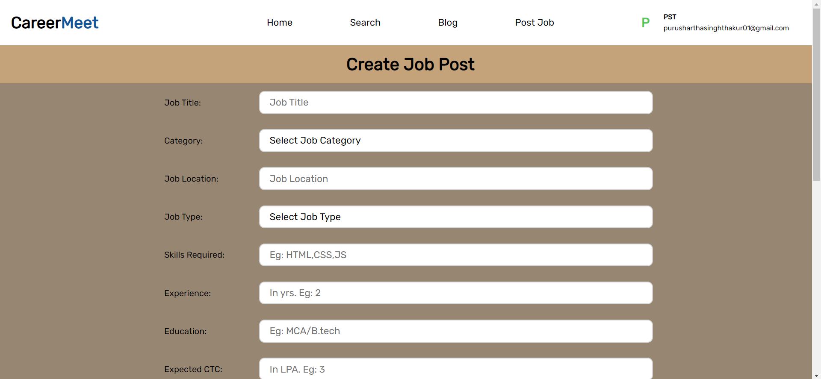
Create Job Post

Slide 26
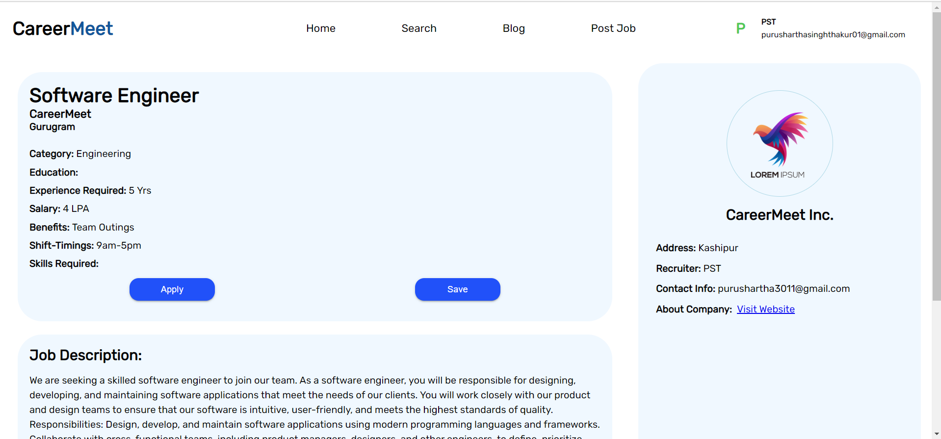
View Job Post

Slide 27
THANKS

